Slide 1
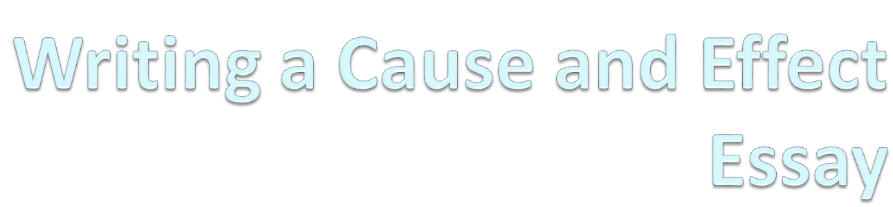

Slide 2
What is Cause & Effect?
When writing about a cause, the writer looks at events that occurred and how they led up to something occurring:
  What were the causes that led up to the 9/11 attack?
When writing about an effect, the writer looks at events that occurred after an event to analyze what has occurred as a result:
  How has Pakistan been affected by the 9/11 attack?

Slide 3
Beyond Events
A Cause or Effect Essay often examines more than events:
  The essay may give reasons or explanations for:
    Events
    Conditions
    Behaviors

Slide 4
Remember the Timeline
When writing this essay, writers who decide to write from the perspective of a cause need to focus on what happened before a specific event. Writers who decide to write from the perspective of an effect need to focus on what happened after a specific event.
Causes
EVENT
Effects

Slide 5
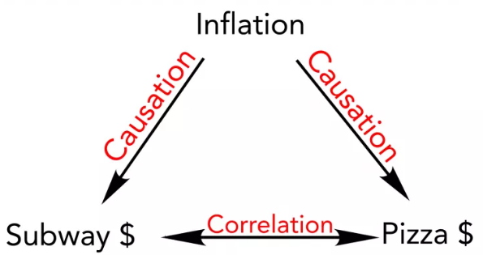
Make Sure to Avoid Correlation
Correlation is different from causation:
  Correlation: there is a connection between two or more things
    While there may be a correlation between children receiving vaccines and cold, that does not mean that the vaccine causes cold
      Think carefully: Does it follows logically. If it doesn’t it’s a correlation and not a cause.
  Causation: something makes something else happen or exist.
    A loud noise may be a causation for a baby crying.

Slide 6
Organizing Thoughts with a Modified Venn Diagram
Causes | Topic | Effects
Record what happened BEFORE the topic. The writer should make certain the list contains at least 6 items so the best 3 can be chosen for the essay. | Record the THESIS STATEMENT here. The writer needs to keep his/her eye on the topic, so recording the thesis statement will help assure the lists are on point. | Record what happened AFTER the topic. The writer should make certain the list contains at least 6 items so the best 3 can be chosen for the essay.
Once the lists above are recorded, review each list carefully.
Which list has the most potential to intrigue the audience?
Which list interests the writer most?
A 5 paragraph essay will not give the writer enough room to write about both causes AND effects. You can have more paragraphs!!

Slide 7
Characteristics to Include in the Essay
Present the event or issue.
  The audience needs to understand the problem or issue. Without this explanation, the analysis will fall apart.
Use strong, assertive language that does not reflect negativity or bias.
Use factual evidence
  Treat the writing scientifically – make a hypothesis and then prove it through direct information from the sources.

Slide 8
Other Questions to Consider:
Does the essay have an effective introduction?
  Hook, transition, interesting thesis
Is the thesis clear, effective? Does it preview the main points?
What are the causes/effects discussed?
Does the writer focus on cause and/or effect?
Is there a good conclusion?

Slide 9
Avoiding Bias and Negativity
Biased or negative statements steal the authority of the writer. Which of the following feels more convincing and has more authority?
  The American public has long been blind to the horrible effects of student debt on our children’s futures. Student debt must be avoided or the consequences will be dire.
  In order for students to succeed in their lives, student debt needs to be studied and considered. Managing the amount of debt taken on will help to assure a college education has the desired effect on one’s life.

Slide 10
3rd Person REQUIRED
For this essay, ALL paragraphs, including the introduction and conclusion, must be in 3rd person.
  3rd person adds a sense of authority and makes the writing more forceful.
    College should be made affordable for everyone in Pakistan.
    By passing policies and instituting that make college more affordable for today’s college student, Pakistan will be better equipped to compete in a global economy.

Slide 11
Types of Causal Relationships
Material cause:
  a material determines its behaviors – a rock falls because of its heaviness.
Formal cause:
  an item’s form determines its nature – a human differs from the statue of a human.
Efficient cause:
  the event that begins the first notable change – a human lifts a rock.
Final cause:
  the ultimate end – often difficult or impossible to predict, especially if all events have not completely played out.

Slide 12
Types of Causal Relationships cont..
Necessary Cause: If x is a necessary cause of y, then the presence of y implies the presence of x. The presence of x does not imply that y will occur.
Sufficient Cause: If x is a sufficient cause of y, then the presence of x implies the presence of y. However, z may also cause y. The presence of y does not imply the presence of x.
Contributory Cause: If the presumed cause precedes the effect, and altering the cause alters the effect, it is contributory.
Wikipedia.

Slide 13
Double Check
The writer should make sure to demonstrate the significance between the causes or the effects in the paper.
Surface thought is boring; deep thought is informative and interesting.

Slide 14
The Pattern
For effect:
  Many causes might lead to one effect:
    Cool kids didn’t study
    Few kids went to college from neighborhood
    College tuition rose faster than inflation
      Effect: College not deemed plausible
For cause:
  One cause might lead to many effects:
    Cause: More jobs require college
      Effect: More students attend community college
      Effect: More students carry massive student debt
      Effect: More students consider which major has best chance of leading to a job.

Slide 15
Let’s write our own essay now!

